Slide 1
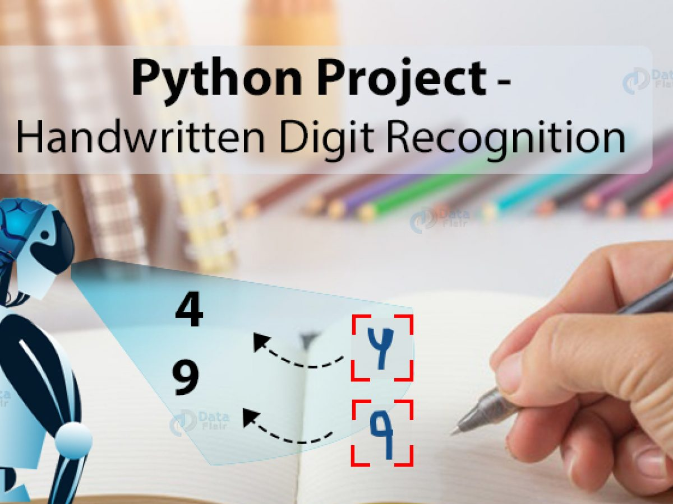
MINI PROJECT
Domain:
Machine Learning
Title:
Handwritten Digit Recognition With Neural Networks
By
Poojasree SJ
Vignesh C
Ramani N

Slide 2
INTRODUCTION
Artificial intelligence refers to the simulation of human intelligence in machines that are programmed to think like humans.
Machine learning is a subfield of Artificial intelligence that provides systems the ability to automatically learn and improve from experience without being explicitly programmed.
The goal of machine learning generally is to understand the structure of data and fit the data into models that can be understood and utilized by people.
Deep learning is a branch of machine learning which is completely based on artificial neural networks, as neural network is going to mimic the human brain. So Deep learning is also a kind of mimic of human brain.
In our Project, we are going to use the concept of Deep learning to recognize human handwritten digits.

Slide 3
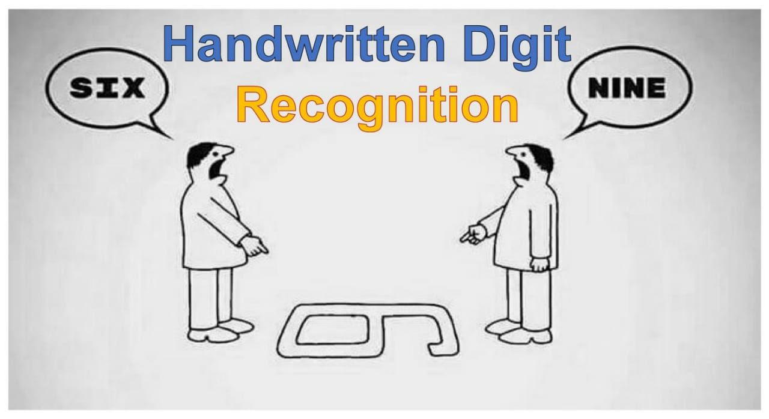
MOTIVATION
The handwritten digits are not always of the same
size , thickness, or orientation and position relative to the margins.
It is a tough task for the machine because handwritten characters are not perfect. The same Characters differ in sizes, shapes and styles from person to person and even from time to time with the same person.
Handwritten Digit recognition is the solution to this problem that uses the image of a digit and recognizes the digit present in the image.
Our goal was to recognize the handwritten digits provided in the MINIST data set of images of handwritten digits.

Slide 4
ABSTRACT
Handwritten Digit Recognition is one of the practically important issues in pattern recognition applications.
Handwritten Digit Recognition is the ability of Computers to recognize Human Handwritten Digits.
The purpose of this project is to take the handwritten digits as an input, process the character, train the Neural Network effectively to recognize the pattern.
Though the goal is to create a model which can recognize the digits, it can be extended to letters and an individual’s handwriting.

Slide 5
LITERATURE SURVEY
S.NO | TITLE | AUTHOR(S) | SOURCE (DETAILS OF PUBLICATION) | FINDINGS
1 | Using Random Forests for Handwritten Digit Recognition | S. Bernard S. Adam L. Heutte | IEEE ( Ninth International Conference on Document Analysis and Recognition (ICDAR 2007)) | This aims at studying those methods in a strictly pragmatic approach, in order to provide rules on parameter settings for practitioners. For that purpose we have experimented the forest-RI algorithm, considered as the random forest reference method, on the MNIST handwritten digits database.
2 | On-line handwritten digit recognition based on trajectory and velocity modeling | MonjiKheralla LobnaHaddad Adel M.Alimi AmarMitiche | Elsevier-- The General Direction of Scientific Research and Technological Renovation (DGRSRT), Tunisia, under the ARUB program , 2008 | A system and associated methodology recognizes an Arabic like alphanumeric character using fuzzy modeling. The method receives a handwritten Arabic like alphanumeric character, stores fuzzy models of a plurality of Arabic like alphanumeric characters…

Slide 6
3 | Handwritten Digit Recognition Using Chemical Reaction Optimization | Pritam Khan Boni Bappy Shahriar Abir Md Rafiqul Islam H.M. Mehedi Hasan | IEEE 2018 9th International Conference on Computing, Communication and Networking Technologies (ICCCNT) | This paper propose a new methodology to recognize handwritten Bengali numerals using a recently established metaheuristic algorithm known as Chemical Reaction Optimization (CRO) in order to increase the recognition accuracy. The proposed method produces a higher accuracy rate, 98.96% which is higher than the outcome of any other proposed method.
4 | Effective handwritten digit recognition based on multi-feature extraction and deep analysis | Caiyun Ma Hong Zhang | IEEE 2015 12th International Conference on Fuzzy Systems and Knowledge Discovery (FSKD) | It propose specific feature definitions, including structure features, distribution features and projection features It results on benchmark database of MNIST handwritten digit images show that the performance of our algorithm is remarkable and demonstrate its superiority over several existing algorithms.

Slide 7
PROPOSED METHODOLOGY
In our Project, we are going to implement a handwritten digit recognition using the MNIST dataset.
We will be using a special type of deep neural network that is Convolutional Neural Networks.
In the end, we are going to build a Graphical User Interface (GUI) in which we can draw the digit and recognize it straight away.

Slide 8
ALGORITHM : CNN
CNN stands for CONVOLUTIONAL NEURAL NETWORKS that are used to extract the features of the images using several layers of filters. The Convolution layers are generally followed by maxpool layers that are used to reduce the number of features extracted and ultimately the output of the maxpool and layers and convolutional layers are flattened into a vector of single dimension and are given as an input to the Dense layer ( The fully connected network).

Slide 9
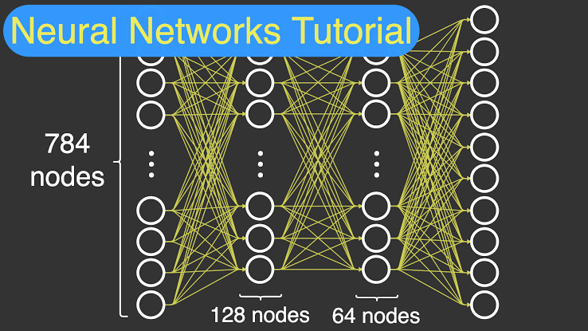
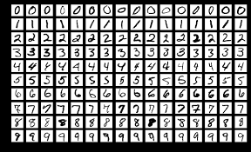
DATABASE:
The Sample database used in our model is MNIST database
MNIST(Modified National Institute of Standards and Technology database)
It was created by "re-mixing" the samples from NIST's original datasets
NIST's training dataset was taken from American Census Bureau employees
The testing dataset was taken from American high school students
Set of 70,000 images of digits handwritten by high school students and employees of the US Census Bureau
In 70,000 images ,each image has 784 features
The black and white images from NIST were normalized to fit into a 28x28 pixel bounding box and anti-aliased, which introduced grayscale levels

Slide 10
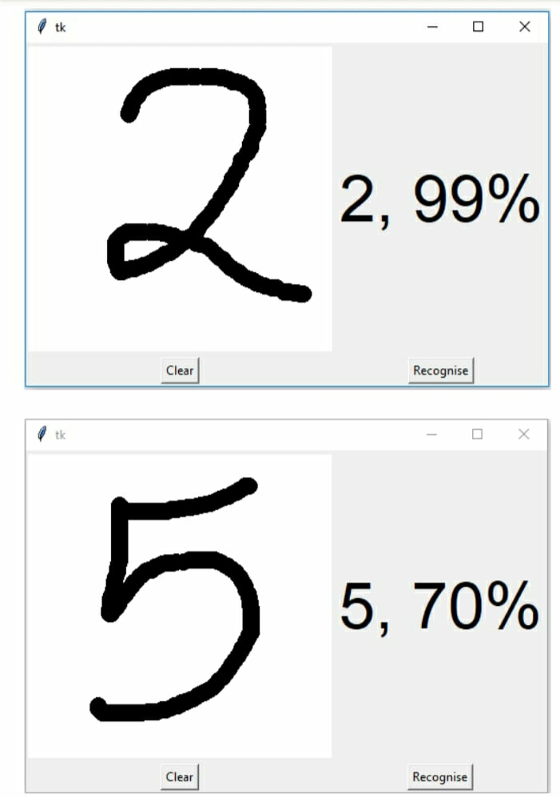
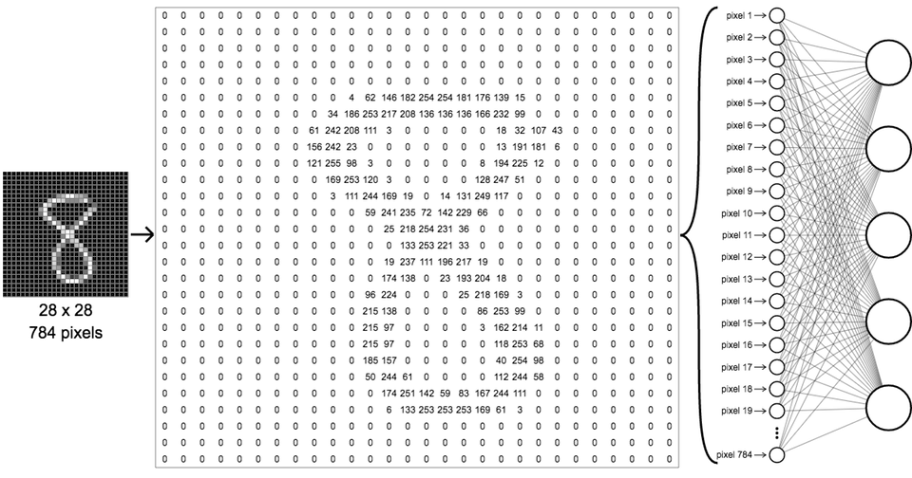
.
MNIST database contains 60,000 training images of handwritten digits and 10,000 images for testing.
Half of the training set and half of the test set were taken
from NIST's training dataset, while the other half of the training set and the other half of the test set were taken from NIST's testing dataset
MNIST database has 10 different classes.
The handwritten digits images are represented as a 28x28 matrix where each cell contains grayscale pixel value.
An extended dataset similar to MNIST called EMNIST
EMNIST has been published in 2017
Whereas MNIST has been published in 1998
which contains 240,000 training images, and 40,000 testing images of handwritten digits and characters

Slide 11
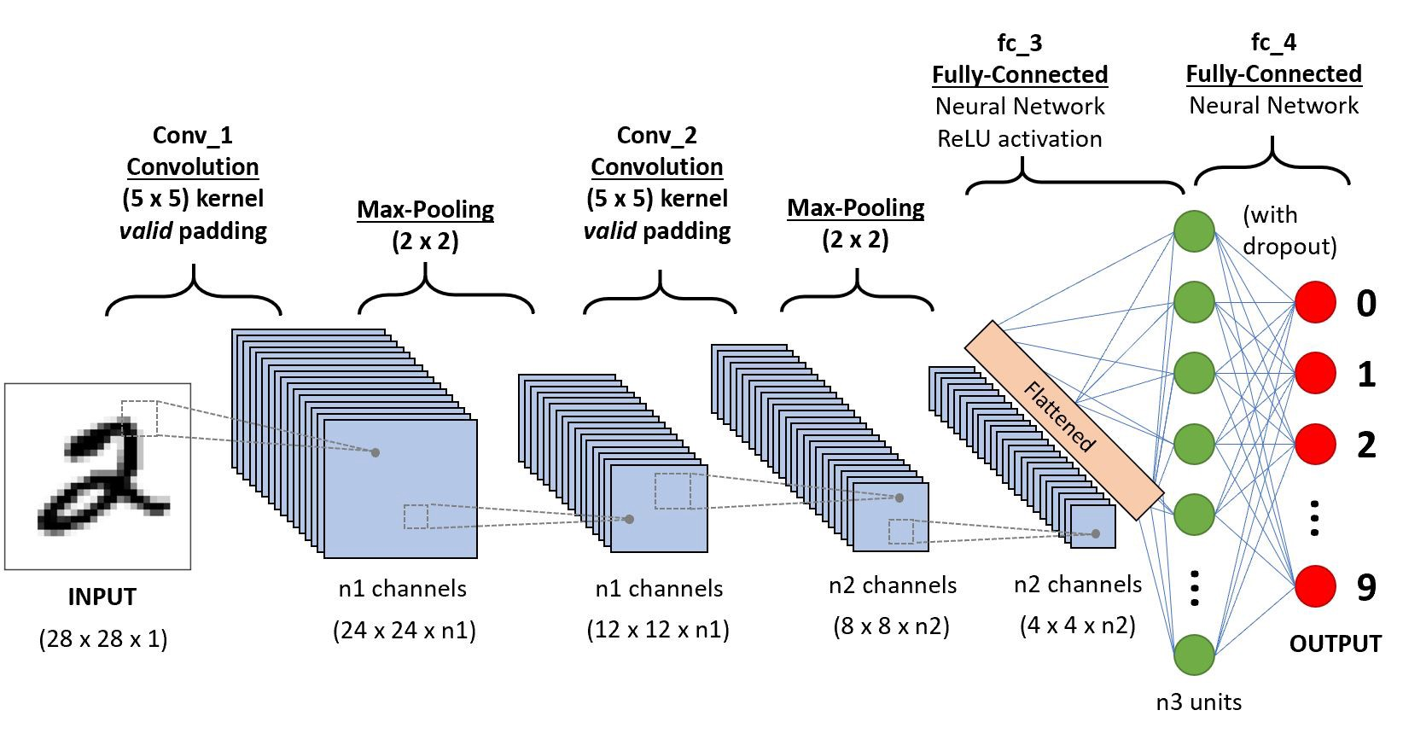
CONCEPTUAL FRAMEWORK

Slide 12
SUPPORTING TOOLS REQUIRED
PLATFORM:
1. Python
2. IDE (Jupyter )
REQUIRED LIBRARIES :
Numpy
pillow
Keras
Tensorflow
Tkinter

Slide 13
REFERENCES
Y. LeCun et al., "Backpropagation applied to handwritten zip code recognition," Neural computation, vol. 1, no. 4, pp. 541- 551, 1989.
A. Krizhevsky, I. Sutskever, and G. E. Hinton, "Imagenet classification with deep convolutional neural networks," in Advances in neural information processing systems, 2012, pp. 1097-1105.
D. Hubel and T. Wiesel, "Aberrant visual projections in the Siamese cat," The Journal of physiology, vol. 218, no. 1, pp. 33- 62, 1971.
Y. LeCun, Y. Bengio, and G. Hinton, "Deep learning," nature, vol. 521, no. 7553, p. 436, 2015.
D. Cireşan, U. Meier, and J. Schmidhuber, "Multi-column deep neural networks for image classification," arXiv preprint arXiv:1202.2745, 2012.
K. Fukushima and S. Miyake, "Neocognitron: A self-organizing neural network model for a mechanism of visual pattern recognition," in Competition and cooperation in neural nets: Springer, 1982, pp. 267-285.

Slide 14
WORKPLAN
Import the Libraries and load the dataset.
Preprocess the data.
Create the CNN Model.
Train the model.
Evaluate the Model .
Create GUI to predict digits.

Slide 15


